Slide 1
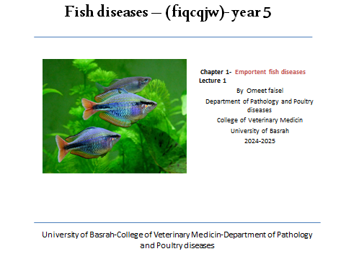
2025-2026

Slide 2
Fungal diseases
Fish in breeding ponds are exposed to several types of fungi in the presence of factors that contribute to infection. Among the most
important fungi that we will mention are:
1- Saprolegniasis.
2- Branchiomycosis.

Slide 3
1-Saprolegniosis in fish
Description
Saprolegniosis is a skin infection caused by a microorganism that affects fish whose protective mucus layer has been altered or that are already compromised by disease or stress. Once the epidermis is contaminated, this microorganism, which looks like a fungus, destroys the superficial and deep layers of the skin.

Slide 4
Signs of the disease
In water, fish have slightly elevated lesions that take on the appearance of cotton wool, but have a gelatinous consistency adhering to the skin. Out of the water, the lesions resemble a thin mat of gelatinous consistency. Initially white, the lesion then turns brownish with a red border. The gills can also be affected.
Lesions can quickly spread to the surface of the skin. The disease can cause fish death.

Slide 5
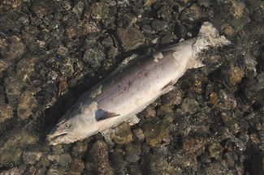
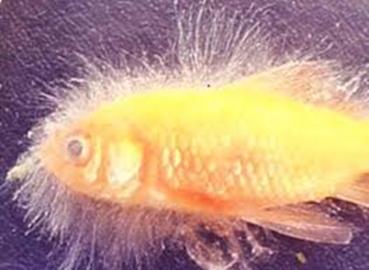
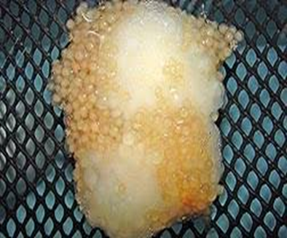
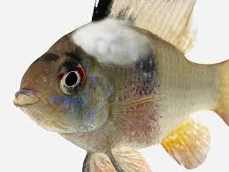
Saprolegnia parasitica

Slide 6
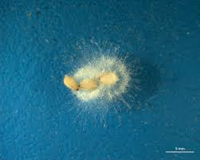
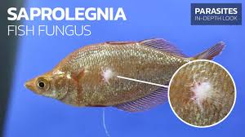
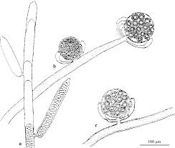
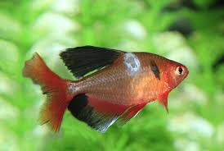
Oomycete

Slide 7
: The causative Saprolegnia parasitica
Symptoms:
1-The presence of cotton fibers
2-Covering the body, eyes, gills, or fins
: Protection
1-Isolation weak & injured fish from the tank
2-Treat wound quickly when they occur
3-Wash egg well
4-Cleaning of water used in incubation devices

Slide 8
Treatment
1-Use abath of potassium permanganate at a concentration of 1g/100 L. of Water.
for a period of 1 – 1.5 h
2-Use salt solution -10 g/ L. Water, for a period 20 Min

Slide 9
2- Branchiomycosis
The disease occurs due to infection with an aquatic fungus that grows within the blood vessels of the gill tissue, known as:
Branchiomyces sanguinis
Branchiomyces demigrans
It infects the gill tissues of most freshwater fish and leads to gill necrosis and loss of appetite. It grows at a temperature of 14-35°C. Spores are transported by water to the gills and stick to them. Then fungal hyphae are produced and penetrate the mucous membranes of the filaments or the blood vessels of the filaments, depending on the type of fungus. The infection occurs quickly within 3-4 days under conditions of water temperature exceeding 20°C.

Slide 10
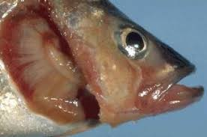
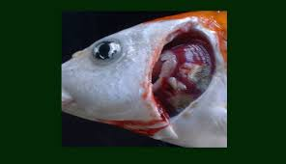
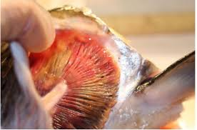
Branchiomycosis

Slide 11
Symptoms
1-The presence of these fungi inside the blood vessels leads to blood clotting in the affected parts of the gills due to the cessation of blood in that area and the tissue of the gills is thinned out.
2-Affected fish are slow or weak in movement.
3-It does not respond to external influences and can be easily handled.
4-Difficulty breathing.
5-The infection rate reaches 100%, and the incidence of drowning reaches 30-50%, and it often occurs in the summer.

Slide 12
Treatment
Use disinfectants for infected ponds, isolate the dead fish, burn them, and bury them. Calcium oxide or 2-3 kg of copper sulphate is used per hectare. The infected fish can be treated with green malachite at a concentration of 0.1 per liter for 12 hours.
It prevents the movement of infected fish to other areas and increases the flow of pure water into the ponds.

Slide 13

تمنياتي بالنجاح

